Slide 1
DeFi Credit Agent
TEAM GLITCH
Pragati Neraki
Syed Zeeyan

Slide 2
Problem Statement
Millions of rural citizens — like farmers, small business owners, and daily-wage workers struggle to get fair access to credit. Traditional banks and lending systems: Require heavy documentation (which many don’t have), often face rejections. As a result, deserving borrowers are left out of the formal financial system.
Our Solution – DeFi Credit Agent
AI-powered web app that acts as a digital credit assistant for rural banks, NGOs, and microfinance groups.
Collects real-life borrower details: income, expenses, credit score, land size, guarantor, UPI transactions, etc.
Uses a trained ML model to instantly predict if the user is eligible for a loan – just like a real loan officer.
Shows graph-based explanation if approved.
Includes AI chatbots (via Ollama) to answer loan/banking questions in simple terms.
Speeds up approvals, removes paperworks and helps build trust in credit decisions for rural users.

Slide 3
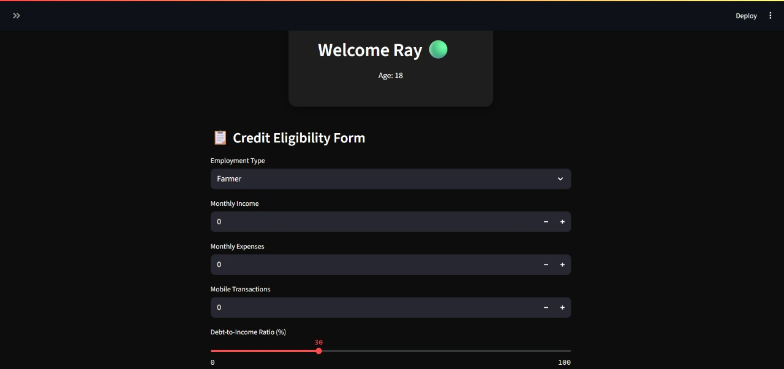
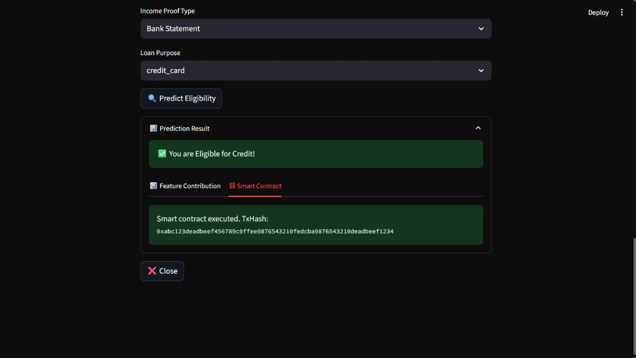
OUTPUT PICTURES

Slide 4
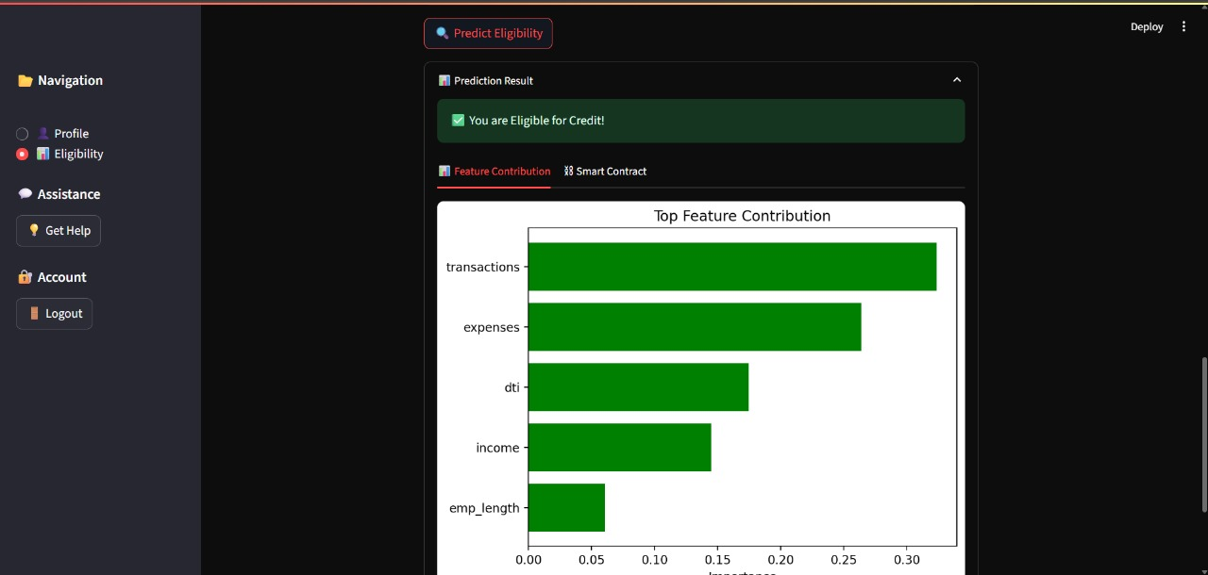
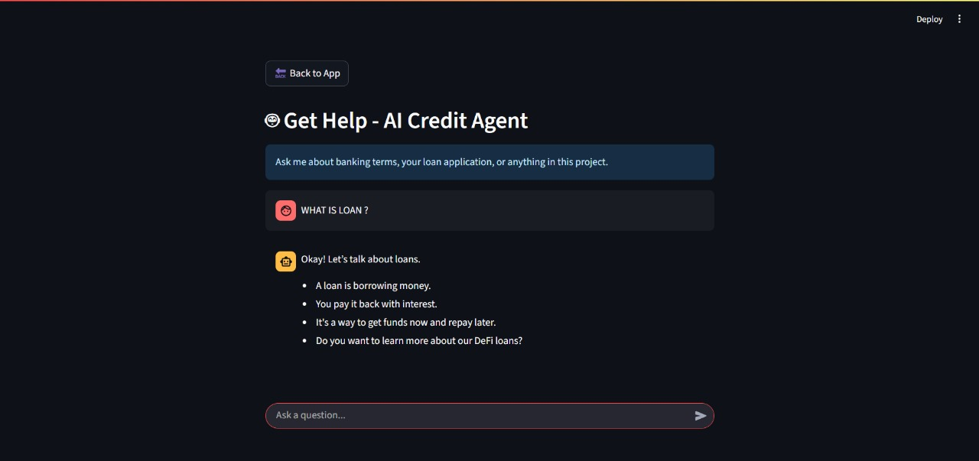

Slide 5
Key Features
AI-based Loan Approval — Uses a trained ML model to approve or reject loans fairly.
Chatbot Support — Built with Ollama (Gemma3) to answer banking questions in real-time.
Smart Contract Simulation — Mimics Ethereum-based contract generation after approval.
User-Friendly Form — Collects farmer/business/salaried inputs easily with instant results.

Slide 6
Future Scope
Integrate real smart contracts on Ethereum for actual loan disbursement.
Upgrade the chatbot to support regional languages like Kannada and Hindi.
Launch a mobile-friendly version for wider rural access.
Add OCR to auto-verify documents like Aadhar/PAN card.

